Slide 1
Firewalls
Presented By
Hareesh Pattipati

Slide 2
Outline
Introduction
Firewall Environments
Type of Firewalls
Future of Firewalls
Conclusion

Slide 3
Introduction
Firewalls control the flow of network traffic
Firewalls have applicability in networks where there is no internet connectivity
Firewalls operate on number of layers
Can also act as VPN gateways
Active content filtering technologies

Slide 4
Firewall Environments
There are different types of environments where a firewall can be implemented.
Simple environment can be a packet filter firewall
Complex environments can be several firewalls and proxies

Slide 5
DMZ Environment
Can be created out of a network connecting two firewalls
Boundary router filter packets protecting server
First firewall provide access control and protection from server if they are hacked

Slide 6
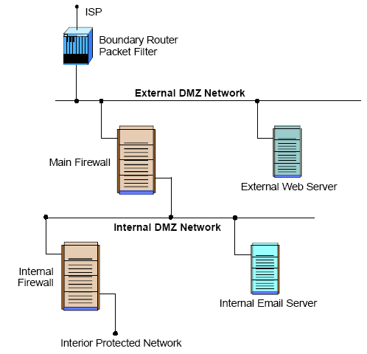
DMZ ENV

Slide 7
VPN
VPN is used to provide secure network links across networks
VPN is constructed on top of existing network media and protocols
On protocol level IPsec is the first choice
Other protocols are PPTP, L2TP

Slide 8
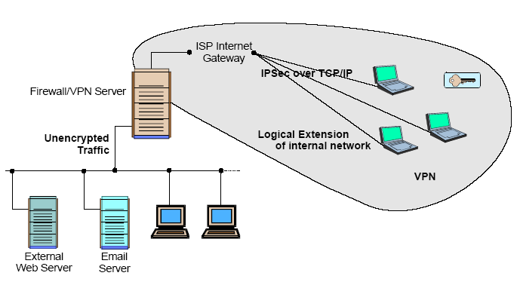
VPN

Slide 9
Intranets
An intranet is a network that employs the same types of services, applications, and protocols present in an Internet implementation, without involving external connectivity
Intranets are typically implemented behind firewall environments.

Slide 10
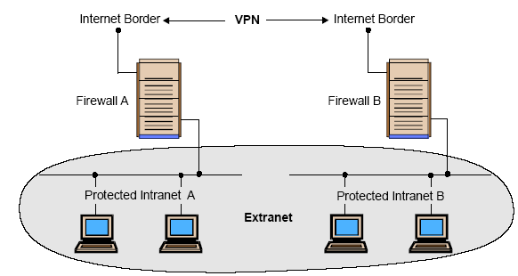
Intranets

Slide 11
Extranets
Extranet is usually a business-to-business intranet
Controlled access to remote users via some form of authentication and encryption such as provided by a VPN
Extranets employ TCP/IP protocols, along with the same standard applications and services

Slide 12
Type is Firewalls
Firewalls fall into four broad categories
Packet filters
Circuit level
Application level
Stateful multilayer

Slide 13
Packet Filter
Work at the network level of the OSI model
Each packet is compared to a set of criteria before it is forwarded
Packet filtering firewalls is low cost and low impact on network performance

Slide 14
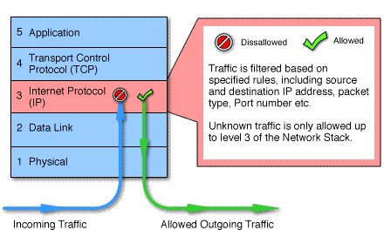
Packet Filtering

Slide 15
Circuit level
Circuit level gateways work at the session layer of the OSI model, or the TCP layer of TCP/IP
Monitor TCP handshaking between packets to determine whether a requested session is legitimate.

Slide 16
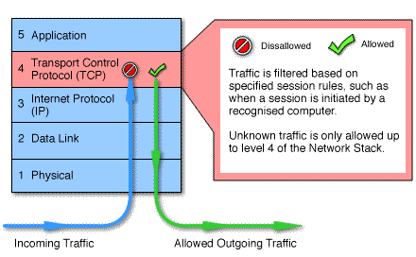
Circuit Level

Slide 17
Application Level
Application level gateways, also called proxies, are similar to circuit-level gateways except that they are application specific
Gateway that is configured to be a web proxy will not allow any ftp, gopher, telnet or other traffic through

Slide 18
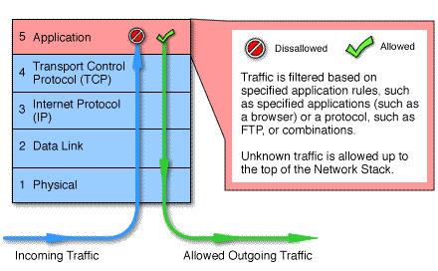
Application Level

Slide 19
Stateful Multilayer
Stateful multilayer inspection firewalls combine the aspects of the other three types of firewalls
They filter packets at the network layer, determine whether session packets are legitimate and evaluate contents of packets at the application layer

Slide 20
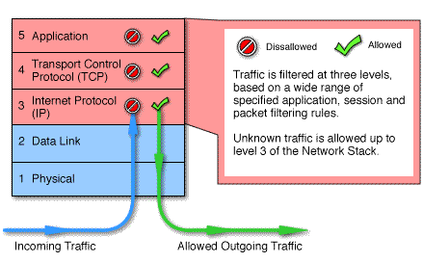
Stateful Multilayer

Slide 21
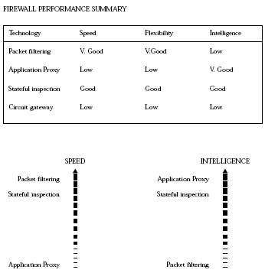
General Performance

Slide 22
Future of Firewalls
Firewalls will continue to advance as the attacks on IT infrastructure become more and more sophisticated
More and more client and server applications are coming with native support for proxied environments
Firewalls that scan for viruses as they enter the network and several firms are currently exploring this idea, but it is not yet in wide use

Slide 23
Conclusion
It is clear that some form of security for private networks connected to the Internet is essential
A firewall is an important and necessary part of that security, but cannot be expected to perform all the required security functions.

